Slide 1
Face Recognition Biometric Security Technology for Secure Data Access
Presented By :-
Shubham Surve
1952046

Slide 2
The A, B, C of the presentation
Section A :- System Overview
Section B :- Roles of the actors
Section C :- Main Section

Slide 3
Section A
System Overview

Slide 4

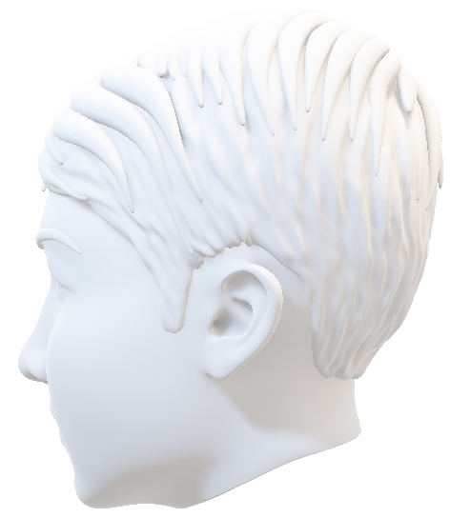
How it works ?
High Definition Camera

Slide 5

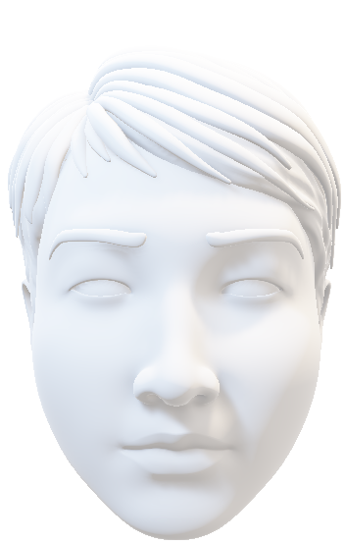
Eyes
Image Processing and Comparison Module
Compares face data with database
Opens database of a client
Nose
Lips

Slide 6
Section A ends

Slide 7
Section B
Role of the actors

Slide 8
What’s the role of the faculty ?

Slide 9
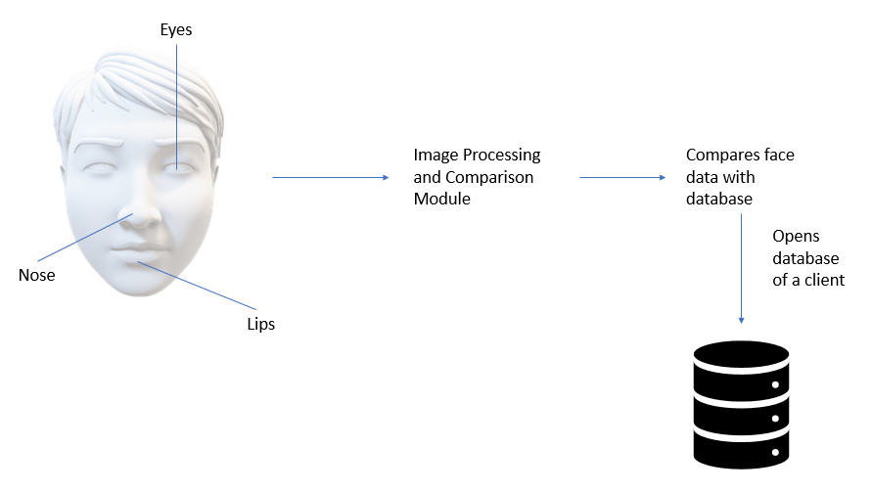

Register
Login
USERNAME
Password
Face Recognizer

Slide 10
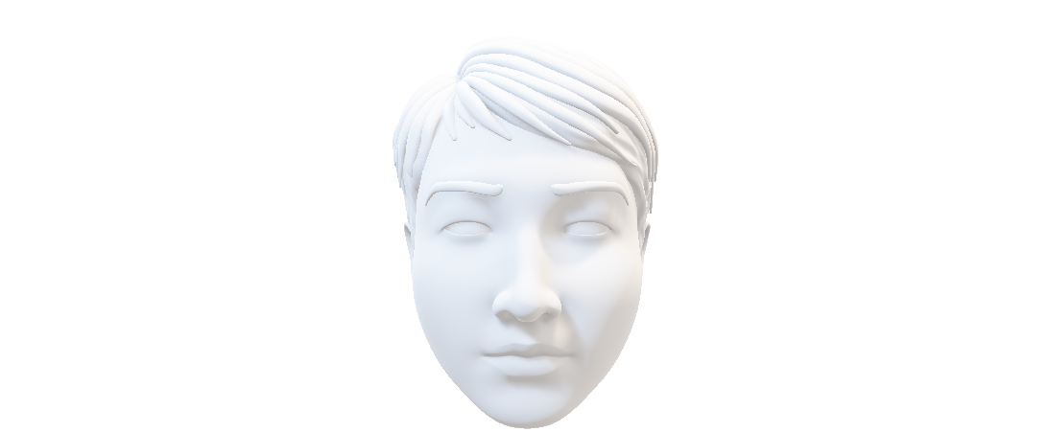
Role of the Client

Slide 11
Section B ends …

Slide 12
Section C
System Requirements
Diagrams

Slide 13
System Requirements
Develop a system in which we can maintain and store the database of a client.
The database will open only after valid credentials and face gets recognized.
System should be smart enough that only right person should get to access the database.

Slide 14
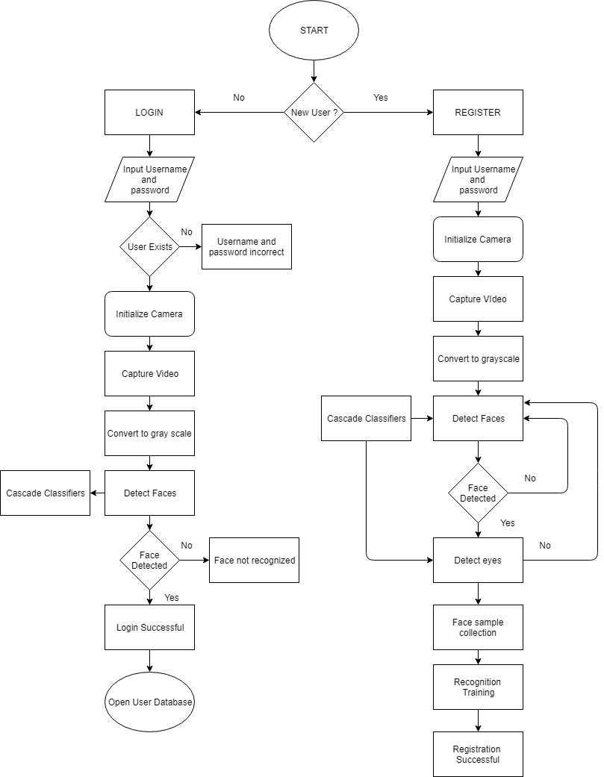
Diagrams

Slide 15
Section C ends

